Slide 1
Part 4: Dividing Networks into Clusters
Notes:
An introductory discussion on graph partitioning

Slide 2
The problem
Graph partitioning and community detection refer to the division of the vertices in a graph based on the connection patterns of the edges
The most common approach is to divide vertices in groups, such that the majority of edges connect members from the same group
Discovering communities in a network can be useful for revealing structure and organization in a network beyond the scale of a single vertex

Slide 3
Visually

Slide 4
Number of groups
Depending on whether we have specified the number of groups we want to divide our network in we have two different problems:
Graph partitioning
Community detection
Even though the general problem is the same, there are different algorithms that deal with each one of the problems

Slide 5
Graph partitioning
In graph partitioning the number of groups k is pre-defined
In particular, we want to divide the network vertices into k non-overlapping groups of given sizes such that the number of edges across groups are minimized
Sizes can also be provided in approximation only
E.g., within specific range
E.g., divide the network nodes into two groups of equal size, such that the number of edges between them is minimized
Graph partitioning is useful in parallel processing of numerical solutions of network processes

Slide 6
Community detection
In community detection neither the number of groups nor their sizes are pre-defined
The goal is to find the natural fault lines along which the network separates
Few edges between groups and many edges within groups
Community detection is not as well-posed of a problem as graph partitioning
What do we mean “many” and “few”?
Many different objectives → different algorithms

Slide 7
Graph partitioning vs Community detection
Graph partitioning is typically performed to divide a large network into smaller parts for faster/more manageable processing
Community detection aims into understanding the structure of the network in a large scale
Identifying connection patterns
Hence, graph partitioning always needs to output a partition (even if it is not good), while community detection is not required to provide an answer if no good division exists

Slide 8
Why partitioning is hard ?
Graph partitioning is an easy problem to state and understand but it is not easy to solve
Let’s start with the simplest problem of dividing a network into two equally sized parts
Graph bisection
Partitioning in an arbitrarily number of parts can be realized by repeated graph bisection
The number of edges between the two groups is called
cut size
Can be thought as a generalized min cut problem

Slide 9
Why partitioning is hard ?
An optimal solution would require to examine all the possible partitions of the network in two groups of sizes n₁ and n₂ respectively. This is:
Such an algorithm would require exponential time and hence, is not appropriate for even moderately small networks
We have to rely on approximation/heuristic algorithms
They require less time but the solution is not optimal (but acceptable)

Slide 10
Kernighan-Lin algorithm
The Kernighan-Lin algorithm is a greedy heuristic for graph partitioning
We begin with an initial (possibly random) partition of the vertices
At each step we examine every pair of nodes (i,j), where i and j belong to different groups
If swapping i and j has the smallest effect on the cut size – i.e., maximum decrease or least increase – we swap i and j
We repeat the above process by considering all pairs across groups but not ones including vertices that have already been swapped
Once all swaps have been completed, we go through all the different states the network passed through and choose the state in which the cut size takes the smallest value

Slide 11
Kernighan-Lin algorithm
We can repeat this algorithm for many rounds
At each round we start with the best division found in the previous round
If no improvement of the cut size occurs during the new round the algorithm terminates
Different initial assignments can give different final partitioning,
We can run the algorithm several times and pick the best solution

Slide 12
Kernighan-Lin algorithm
Despite being straightforward Kernighan-Lin algorithm is slow
At every round the number of swaps is equal to the size of the smaller of the groups → O(n)
At every step of every round we have to check all the possible pairs of nodes that belong to different groups and we have not yet swapped → O(n²)
For each of these pairs we need to determine what is the change in the cut size if we swap them

Slide 13
Kernighan-Lin algorithm
If k_{i}^{same} are the number of edges that node i has with vertices belonging to the same group and k_{i}^{other} are the edges i has across groups, then the total change in the cut size if we swap i and j is:
Evaluation of the above expression depends on the way we store the network
Adjacent list: O(m/n)
With some tricks and with adjacent matrix: O(1)
Nevertheless, the overall running time is O(n³)
Notes:
The number of rounds required is not well understood how it varies with the network size. However, in typical applications is small.

Slide 14
Spectral partitioning
Let us consider that the vertices are partitioned in groups 1 and 2
The total number of edges between vertices of these groups is:
Let’s define:
Then:

Slide 15
Spectral partitioning
Hence, we can now write R as:
The summation now takes place over all i and j
We also have:
Hence, we can write:
L is the Laplacian matrix

Slide 16
Spectral partitioning
The above optimization problem is the formal definition of the graph partitioning (bisection)
The reason why it is hard to solve is the fact that the elements s_{i} cannot take any real value but only specific integer values (+/- 1)
Integer optimization problems can be solved approximately using the relaxation method

Slide 17
Spectral partitioning
In the original integer problem the vector s would point to one of the 2^{n} corners of an n-dimensional hypercube centered at the origins
The length of this vector is
We relax the above constraint by allowing the vector s to point to any direction as long as its length is still

Slide 18
Spectral partitioning
A second constraint in the integer optimization problem is the fact that the number of elements in vector s that equal +1 or -1 needs to be equal to the desired sizes of the two groups:
We keep this constraint unchanged
So we have a minimization problem subject to two equality constraints
Lagrange multipliers

Slide 19
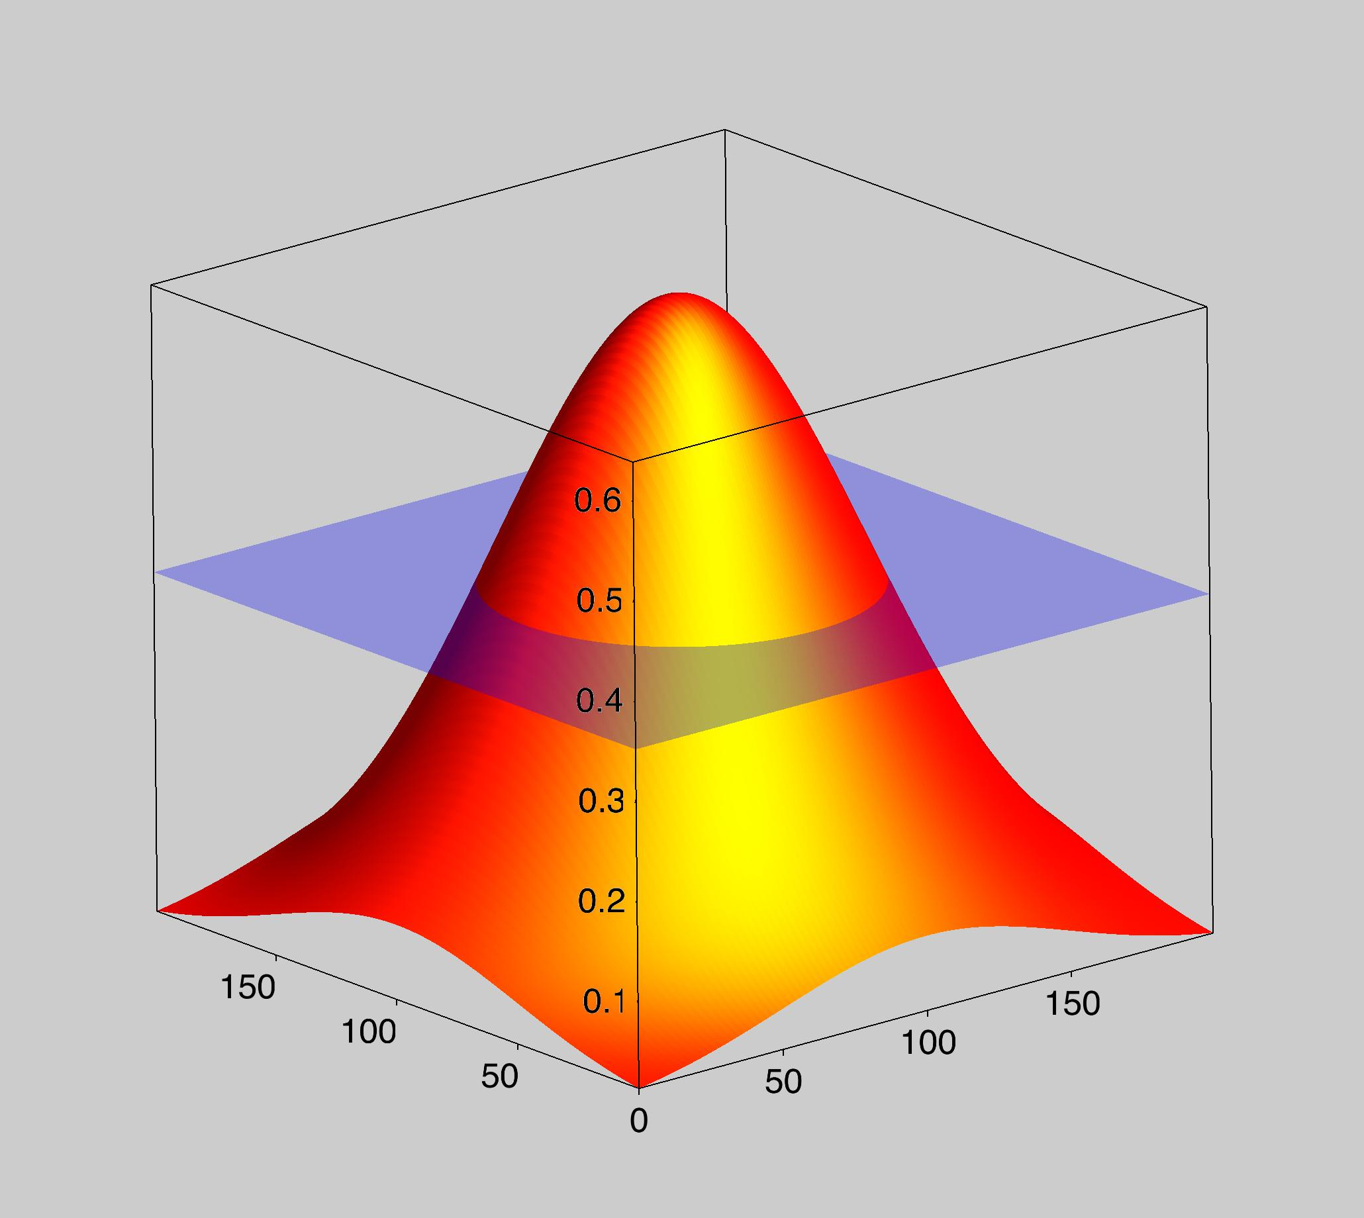
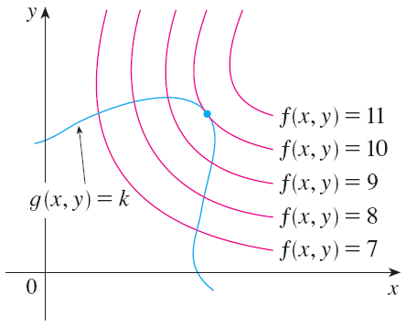
Concept of Lagrange multipliers (2 variables)
The figure shows this curve together with several level curves of f.
These have the equations f(x, y) = c, where c = 7, 8, 9, 10, 11

Slide 20
LAGRANGE MULTIPLIERS—TWO VARIABLES
To maximize f(x, y) subject to g(x, y) = k is to find:
The largest value of c such that the level curve f(x, y) = c intersects g(x, y) = k.

Slide 21
LAGRANGE MULTIPLIERS—TWO VARIABLES
It appears that this happens when these curves just touch each other—that is, when they have a common tangent line.
Otherwise, the value of c could be increased further.

Slide 22
LAGRANGE MULTIPLIERS—TWO VARIABLES
This means that the normal lines at the point (x₀ , y₀) where they touch are identical.
So the gradient vectors are parallel.
That is, for some scalar λ.

Slide 23
LAGRANGE MULTIPLIERS—THREE VARIABLES
This kind of argument also applies to the problem of finding the extreme values of f(x, y, z) subject to the constraint g(x, y, z) = k.
Thus, the point (x, y, z) is restricted to lie on the level surface S with equation g(x, y, z) = k.

Slide 24
LAGRANGE MULTIPLIERS—THREE VARIABLES
Instead of the level curves in the previous figure, we consider the level surfaces f(x, y, z) = c.
We argue that, if the maximum value of f is f(x₀, y₀, z₀) = c, then the level surface f(x, y, z) = c is tangent to the level surface g(x, y, z) = k.
So, the corresponding gradient vectors are parallel.
Therefore, if, there is a number λ such that:
The number λ in the equation is called a Lagrange multiplier.

Slide 25
TWO CONSTRAINTS
So, there are numbers λ and μ (called Lagrange multipliers) such that:

Slide 26
Spectral partitioning
The vector (1,1,…,1)^{T} is an eigenvector of L with eigenvalue 0. Hence, if we multiply the above equation on the left with (1,1,…,1) we have:
If we define: we finally get:

Slide 27
Spectral partitioning
The last equations tells us that vector x is an eigenvector of the Laplacian, with eigenvalue λ
Given that any eigenvector will satisfy this equation we will pick the one that minimizes R
However, it cannot be the vector (1,1,…,1) since:
Vector x is orthogonal to vector (1,1,…,1)
So which eigenvector ?

Slide 28
Spectral partitioning
We rewrite R as:
Hence, the cut size is proportional to the eigenvalue λ
We pick the second lowest eigenvalue λ₂ (since λ=0 cannot be a solution as we saw) and then vector x is proportional to the eigenvector v₂
Finally vector s is given by:
This vector is relaxed

Slide 29
Spectral partitioning
How do we transform the obtained vector s to one with values only +/- 1 ?
We simply set the n₁ most positive values of the relaxed vector s equal to 1, and the rest equal to -1
Since vector x, and hence vector s, are proportional to the eigenvector v₂ of the Laplacian we finally have a very simple result
Calculate the eigenvector v₂ of the Laplacian and place the n₁ vertices with the most positive elements in v₂ to group 1 and the rest to group 2
When n₁ and n₂ are not equal, there are two ways of making the split. Which do we pick?

Slide 30
Spectral partitioning
The final steps are as follows:
Calculate the eigenvector v₂ that corresponds to the second smallest eigenvalue λ₂ of the graph Laplacian
Sort the elements of the eigenvector in order from the largest to smallest
Put the vertices corresponding to the n₁ largest elements in group 1, the rest in group 2 and calculate the cut size
Put the vertices corresponding to the n₁ smallest elements in group 1, the rest in group 2 and calculate the cut size
Between these two divisions of the network, choose the one that gives the smaller cut size

Slide 31
Spectral partitioning
In general the spectral partitioning will find divisions of a network that have the right shape, but are not as good as the ones obtained by other algorithms
However, the main advantage is the speed and hence its scalability
O(mn) in sparse network

Slide 32
Algebraic connectivity
We have seen before that the second smallest eigenvalue of the graph Laplacian informs us whether the network is connected or not
Now when the network is connected its value tells us how easy is to divide the network
We saw that the cut size is proportional to λ₂
Small λ₂ means that the network has good cuts
Can be disconnected by removing a few edges

Slide 33
Community detection
Community detection is primarily used as a tool for understanding the large-scale structure of networks
The number and size of groups are not specified
Community detections aims into finding the natural division of the network into groups
The fault line along which the network is divided into groups is not well defined and so is our problem
Let’s start with the simplest community detection problem instance
We want to divide the network again into two groups but now we do not know the size of these groups

Slide 34
Community detection
One solution would be to perform graph bisection with one of the algorithms presented before for all combinations of n₁ and n₂ and pick the one with the smallest cut size
This will not work (why?)
Another approach is to define the ratio cut partitioning:
Now instead of minimizing R, we want to minimize the above
ratio
The denominator takes its maximum value when n₁=n₂=0.5n, while it diverges if one of the quantities is zero
Hence, the solution where n₁ or n₂ equals to zero is eliminated, but still the solution is biased (now towards equally sized groups)
Notes:
- Because this will always give as solution the bisection where n1=n and n2=0

Slide 35
Community detection
It has been argued that cut size is not a good metric for evaluating community detection algorithms
A good division is one where edges across groups are less than the expected ones if edges were places in random
It is not the total cut size that matters but how it compares with what we expect to see
Conventionally in the development of the community detection algorithms one considers the edges within groups

Slide 36
Community detection
This approach is similar to the thinking developed for the assortativity coefficient and modularity
Modularity takes high values when connections between vertices of the same type are higher than the number of connections expected at random
In the context of community detection, the vertices of the two groups can be considered to be of the same type
Good divisions are the ones that have high values of the corresponding modularity
Community detection is also an NP problem

Slide 37
Simple modularity maximization
One straightforward approach is an algorithm analogous to the Kernighan-Lin graph bisection
We start with a random division of the network into equally sized groups
At each step go through all vertices and compute the change in the modularity if this vertex was placed to the other group
Among all vertices examined swap groups to the one that has the best effect on modularity – i.e., largest increase or smallest decrease
We repeat the above process by considering only the vertices that we have not already swaped

Slide 38
Simple modularity maximization
As with the Kernighan-Lin algorithm, after we go through all vertices we go through all the states of the network and keep the one with the higher modularity
We repeat the whole process starting with the best network that we identified in the previous round, until the modularity no longer improves
The time complexity of this algorithm is significantly less than the one of Kernighan-Lin algorithm
In this case we go through single vertices and not all possible pairs
Complexity O(mn)

Slide 39
Spectral modularity maximization
The modularity matrix B is defined as:
The modularity matrix has the following property:
Let’s consider the simplest case again, that is dividing the vertices into two groups
We define again s_{i} similar to the case of spectral partitioning. Hence,

Slide 40
Spectral modularity maximization
Using the above we can write the modularity of the network as:
The above objective function is of the same form as the one for the spectral bisection
We still have the constraint
The only difference is that we do not have the constraint for the sizes in the groups
As before we solve the problem using the relaxation method
One Lagrange multiplier now

Slide 41
Spectral modularity maximization
In other words vector s in this problem is an eigenvector of the modularity matrix
Hence,
For maximum modularity, we pick vector s to be the eigenvector that corresponds to the maximum eigenvalue of the modularity matrix

Slide 42
Spectral modularity maximization
For removing the relaxation we want to maximize: s^{T}u₁ (why?)
We approximate vector s as following:
Modularity matrix is not sparse hence the running time can be high
By exploiting properties of the modularity matrix we can still compute the eigenvector in O(n²) for a sparse network
Notes:
Both approaches are not prohibitively slow, so since they are heuristics we can use both for validation etc.

Slide 43
Division into more than two groups
In the case of community detection we cannot simply continue dividing the output pairs of the community detection algorithms for two communities
The modularity of the complete network does not break up into independent contributions from the separate communities
We must explicitly consider the change ΔQ in the modularity of the entire network upon further bisecting the community c of size n_{c}

Slide 44
Division into more than two groups
The above problem has the same format as the spectral modularity maximization
Hence, we find the leading eigenvector of B^{(c)} and divide the network according to the signs of its elements
When do we stop this iterative process?
If we are unable to find any division of a community that results in a positive change ΔQ in the modularity, we leave that community undivided
The leading eigenvector will have all elements with the same sign
When we have subdivided the network to the point where all communities are in this indivisible state, the algorithm terminates

Slide 45
Division into more than two groups
The repeated bisection is by no means perfect
As we have mentioned we can even attempt to find directly the maximum modularity over divisions into any number of groups
This can, in principle, find better divisions
More complicated and slower

Slide 46
Other modularity maximization methods
Simulated annealing
Genetic algorithms
Greedy algorithms
We begin with every node belonging to a different community
At every step we combine the pair of groups whose amalgamation gives the biggest increase in modularity, or the smallest decrease if no choice gives an increase
Eventually all vertices are combined into a single group
We then trace back the states over which the network passed and we select the one with the highest value of modularity
Time complexity O(nlog²n)
The modularity achieved with greedy algorithms is slightly lower but it is much faster compared to the other two approaches

Slide 47
Betweenness-based method
While graph partitioning is a problem well-defined objective function (i.e., minimize cut set) the same does not hold true for community detection
Modularity maximization is only one of the possible ways to tackle the problem
Different objective functions can lead to different algorithms
One alternative to modularity maximization is to find edges that lie between communities
Once we remove them we will be left with just the isolated communities

Slide 48
Betweenness-based method
Edge betweenness is the number of geodesic paths that go through an edge
Edges that lie between communities are expected to have high betweenness because they will connect roughly all pairs of vertices between the communities
Time to calculate edge betweenness is O(n(m+n))

Slide 49
Betweenness-based method
We calculate the betweenness of each edge
We find the edge with the highest score and remove it
We recalculate the betweenness of the remaining edges, since geodesic paths will have changed
Repeat the above process until we eventually have a completely disconnected network
Singleton vertices

Slide 50
Betweenness-based method
The states of the network passes through the above procedure can be represented using a dendrogram
Leaves represent the final state (i.e., singleton nodes) while the top of the tree represents the starting state (i.e., a single community)
Horizontal cuts represent intermediate configurations
This algorithm gives a selection of different possible decompositions of the network
Coarse (i.e., top of the tree) vs fine
divisions (i.e., bottom of the tree)

Slide 51
Betweenness-based method
The above algorithm gives very good results
However it is one of the slowest algorithms for community detection
O(n³) in a sparse network
The ability to get an entire dendrogram rather than a single decomposition can be useful in many cases
Hierarchical decomposition

Slide 52
Betweenness-based method
A variation of the above algorithm is based on the observation that an edge that connects two components that are poorly connected with each other is unlikely to participate to many short loops
Thus, one can identify the edges between communities by examining the number of short loops they participate in (rather than the betweenness)
Radicchi et al. found that examining for loop lengths 3 and 4 gave the best results

Slide 53
Betweenness-based method
This approach is an order of magnitude faster compared to the betweenness-based approach
Computing short loops to which an edge belongs is a local operation
However, this approach works well when the network has a significant number of short loops to begin with
Social networks do have many short loops, however other types of networks (e.g., technological or biological) might not have this property

Slide 54
Hierarchical clustering
The betweenness-based community detection provided as an output a dendrogram
The dendrogram essentially decomposes the network into nested communities in a hierarchical fashion
There is an entire class of algorithms that are doing the same thing but operate using an agglomerative strategy rather than a divisive one
Hierarchical clustering algorithms
Notes:
The greedy algorithms we discussed before were also agglomerative

Slide 55
Hierarchical clustering
The basic idea behind hierarchical clustering is to initially consider every vertex as one community
Then we define a metric of similarity between vertices, based on the network structure
Then we join the most similar vertices to the same group
We can use any metric of structural equivalence as the similarity metric
Cosine similarity, correlation coefficient between rows in the adjacent matrix, Euclidean distance between rows in the adjacent matrix etc.
Notes:
The fact that we can use many metrics is both good and bad.
Good → gives flexibility
Bad → there is no principle based on which we decide which metric to use (trial-and-error method)

Slide 56
Hierarchical clustering
Once we calculate the pairwise similarities, our goal is to group together the vertices that have the highest similarities
This can lead to conflicts
The first step is to join the singleton pairs with the highest similarity to a group of size two
Then we need to agglomerate groups with possibly more than one vertices
However, we have metrics for pairwise similarity not group similarity
How can we combine these vertex similarities to
create similarities for the groups?

Slide 57
Hierarchical clustering
Consider two groups of n₁ and n₂ vertices respectively
There are n₁n₂ pairs of vertices among them (one node belongs to group 1 and the other to group 2)
Single-linkage clustering
The similarity between the groups is defined as the maximum of the pairwise similarities
Complete-linkage clustering
The similarity between the groups is defined as the smallest of the pairwise similarities

Slide 58
Hierarchical clustering
Average-linkage clustering
The similarity between the groups is defined as the mean of the pairwise similarities
Single-linkage clustering is very lenient, while complete-linkage clustering is more stringent
Average-linkage clustering is a more satisfactory definition and in between the two extremes, but it is rarely used in practice

Slide 59
Hierarchical clustering
The full hierarchical clustering method is:
Choose a similarity metric and evaluate it for all vertex pairs
Assign each vertex to a group of its own, consisting of just that one vertex
The initial similarities of the groups are just the similarities of the vertices
Find the pair of groups with the highest similarity and join them together into a single group
Calculate the similarity between the new composite group and all others using one of the three methods above (single-, complete- or average-linkage clustering)
Repeat from step 3 until all vertices have been joined to a single group

Slide 60
Hierarchical clustering
Time complexity O(n²logn) using a heap
With union/find and single-linkage clustering we can speed up to O(n²)
Hierarchical clustering does not always work well
It is able to find the cores of the groups, but tends to be less good at assigning peripheral vertices to appropriate groups
Peripheral nodes are left out of the agglomerative clustering until the very end
Hence, we have a set of tightly knit cores surrounded by a loose collection of single vertices or smaller groups
However, even this might be valuable information for the network structure
Notes:
Cores of groups consists of groups that are highly similar to each others

